Slide 1
IMPLEMENTATION ASPECTS
FOR
INTERFERENCE ALIGNMENT
CENK M. YETIS*, Mevlana University, Turkey
KUSHAL ANAND, nanyang technologıcal unıversıty, sıngapore
AHMET H. KAYRAN, ISTANBUL TECHNICAL University, Turkey
YONG l. Guan, nanyang technologıcal unıversıty, sıngapore
Erry gunawan, nanyang technologıcal unıversıty, sıngapore
* cenkmyetis@gmail.com
Notes:
In this presentation, we will go through necessary testbed implementations to take IA closer to being used in real life scenarios. This short work is a collaboration with my Msc and Phd advisor at ITU and my colleague and my advisors during my post-doc years at NTU

Slide 2
AGENDA
Part I – Review of IA Testbeds
Part II – Review of SDR Testbeds
Notes:
The agenda is short as this presentation is. The first part is… The second part is… I go through SDR testbeds in general sense to see how further we need to go by taking examples of testbed implementations of stronger candidates that will be applied in near future such as cognitive radio and massive MIMO. Please note that I do not have an established testbed at the moment, and I don’t have an expert experience on testbeds but hopefully soon I will get into the world of testbed research. Therefore please forgive me if you find some slides at the presentation repetitive and trivial for you.

Slide 3
Part I - Review of IA testbeds

Slide 4
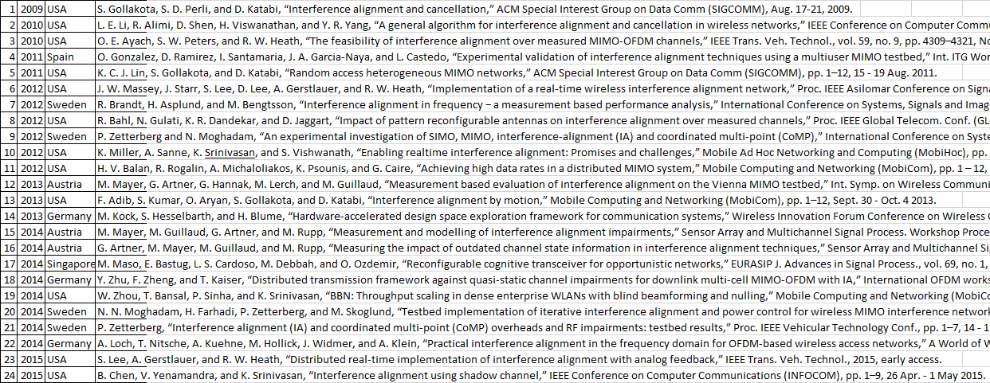
Review of ia testbeds
Notes:
Here are the published conference and journal IA papers on testbed researches. Although there are some Arxiv papers, technical reports, or some papers presented at 2015 conferences, they are not included in this list. Only published papers are here. If there is a collaboration among multiple countries, I listed the first author’s country. There is a reason for this list because I will show you some statistics in the following slides. We will go through each paper in the next slide. We have so far 24 published papers over the course of 6 years, 3 out of 24 are journals, clearly Heath’s research group seems to be further in this IA testbed implementation arena. So 2 of the journals belong to Heath’s group.
So when we look at this table, we understand that IA is still not a strong candidate for near future wireless networks, let’s see why in the next slide.

Slide 5
Review of ia testbeds
IA is still far to be utilized in the near future, some signs are
Small number of IA testbed papers
Uninterested research groups with long ago established testbeds that use different software and hardware platforms,
  e.g., no IA testbed results on dedicated, WARP, Iris, and BEE platforms
No really expensive IA testbeds, e.g., K-user interference channel, K>3
No IA live demonstrations at conferences, e.g., IEEE DySPAN
No appear of IA in any IEEE magazine, e.g., spectrum and communications magazines
If sounds unconvincing,
please kindly check MASSIVE MIMO or COGNITIVE RADIO
for each item
Notes:
As we said before, IA is far to be utilized in the near future, here are some signs
- There is a small number of testbed papers, definitely 24 is a small number over 6 years time.
- Although there are many established testbeds by the research groups around the world, we see that most groups are still uninterested.
- So far, the largest IA testbed network is a 3-user IC. This clearly shows that expensive IA testbed investment for larger network setups is not seen worth the cost currently.
- If the scheme really attracts the industry, live demonstrations are displayed at conferences by researchers from both academia and industry, so far no live demonstration has been done for IA at a conference.
- IA did not appear in any IEEE magazine, I think even this item alone is sufficient enough to consider IA is still far to be applied in near future networks.
If I sound unconvincing, please kindly check these items for massive MIMO for which you will see multiple times for each item.

Slide 6
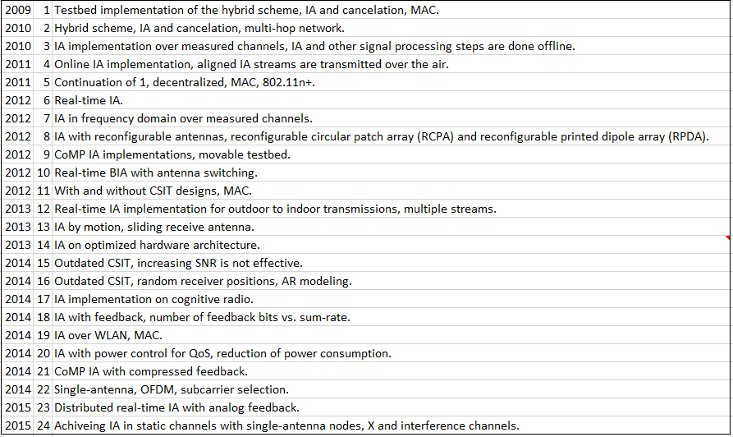
REVIEW OF IA TESTBEDS
Notes:
Now let’s through IA testbed papers briefly and quickly. So the first paper was published in 2009, it is a joint scheme of IA and cancellation. Basically this research group believes that IA can be applied in WiFi networks, so transmitters can be the mobile users and receivers can be the access points so we can do cancellation at the receiver side over the LAN as well.
All these papers are important in their own respects but some are leading more than others in my opinion. This one can be among those some. For example, you see optimized hardware architectures for MIMO communications such as realizing succesive cancelation, or such as realizing different decoder types say sphere decoders, so I mean these works consider algorithm and hardware design together, in the end the product is definitely hardware optimized algorithm. Without considering hardware, algorithm optimization such as minimizing the number of multiplications, eigen value evaluations is not really hardware optimized approach. Because in the end, you want to trim (simplify) parts of your algorithm so that it can be applied in real life, but the value of each part is different. Without hardware tests, your optimization approaches can even be further from reality if you don’t have hardware experience.

Slide 7
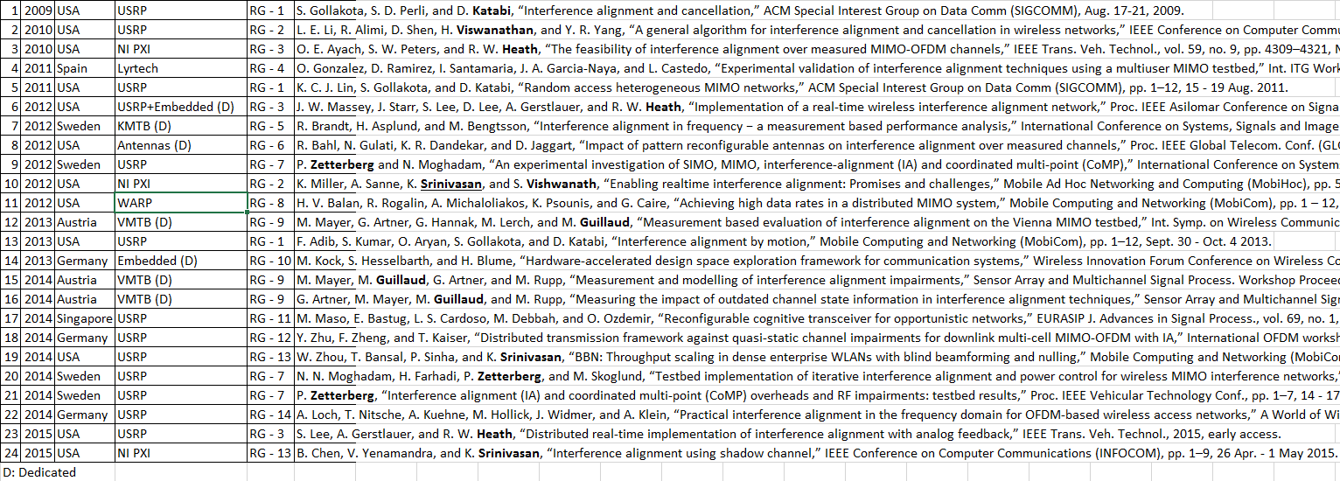
REVIEW OF IA TESTBEDS
Notes:
Here we see two additional columns to the previous list. In this column, we see the testbed hardware platforms used by the research groups. Clearly USRP testbeds are the leading choices. Anything except USRP, PXI, and WARP (https://warpproject.org/trac/wiki/hardware, Mango Communications) are called dedicated because they are not really off-the shelve testbeds. These testbeds have hardware components dedicated by some specific people, or in short they are not for sale yet. So in this respect, KMTB (Kista MIMO testbed-Germany), VMTB (Vienna MIMO testbed-Austria) are dedicated testbeds. Here in the 8th one, that’s the testbed where two types of antennas are used, so it is also dedicated. In 6th and 14th, they also go for embedded platforms, so it is also called dedicated. As far as I see, we can say there are 14 research groups that have implemented IA on their testbeds. How do we differentiate reseach groups from one another, for example we check authors names, if an author appears in more than one paper, I assume all authors of those two papers as 1 research group such as when you check 20 and 21, similarly for 3 and 23. So in this respect, it might be better saying know-how groups not research groups.

Slide 8
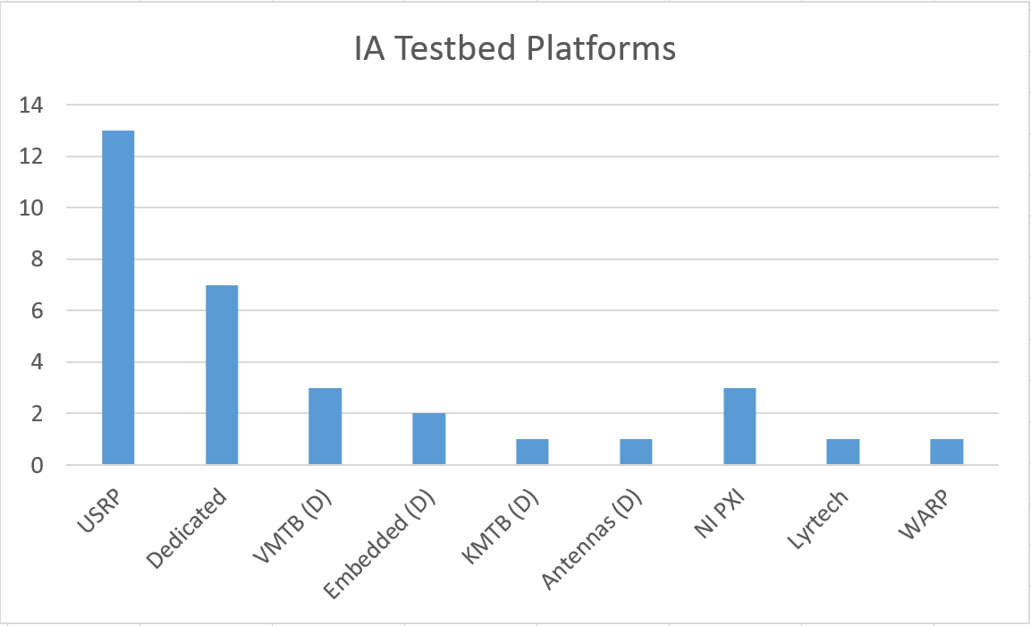
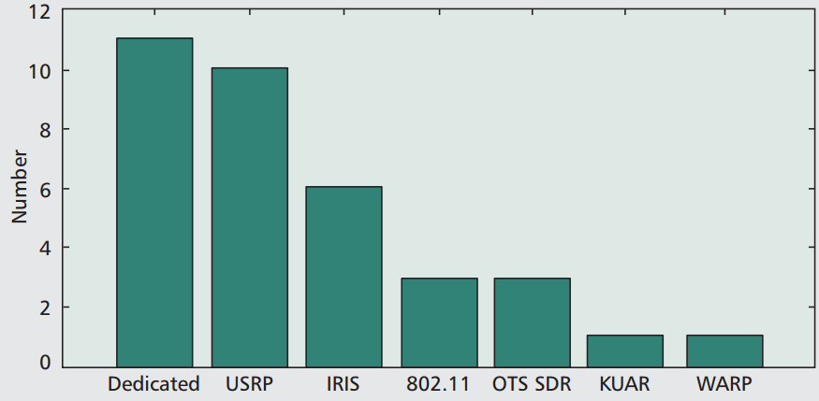
Review of ia testbeds
© Pawelczak, P. et. al, Cognitive Radio: Ten Years of
Experimentation and Development, March 2011

Slide 9
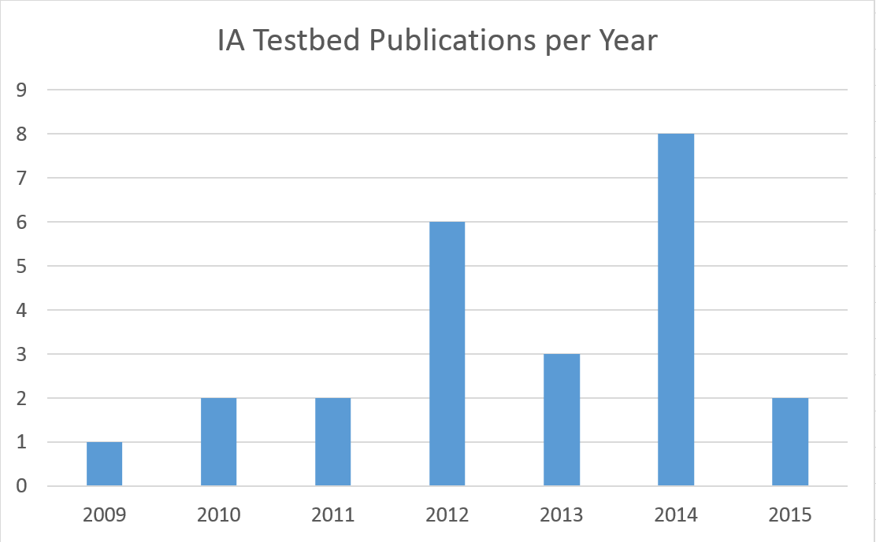
REVIEW OF IA TESTBEDS

Slide 10
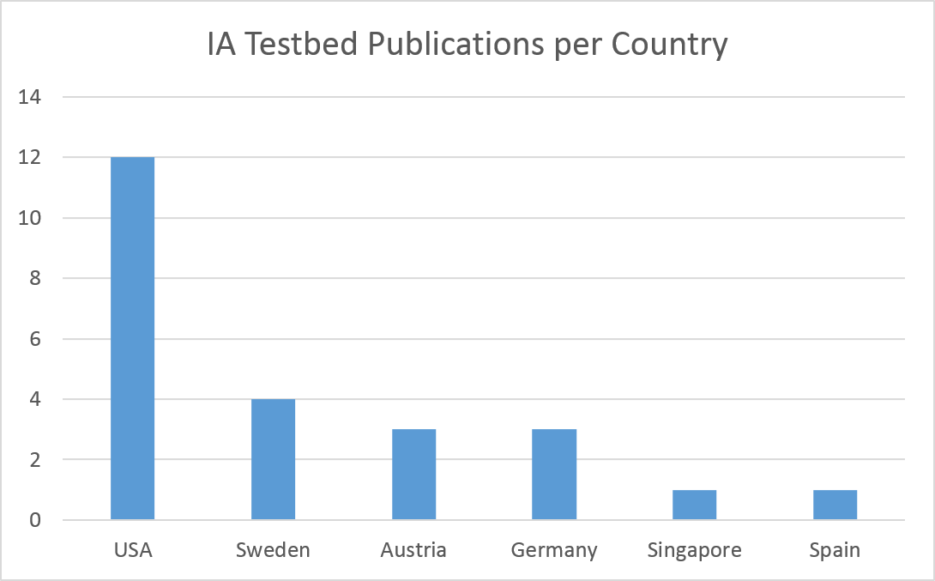
REVIEW OF IA TESTBEDS

Slide 11
REVIEW OF IA TESTBEDS
Missing or less explored IA testbed implementations
  Multiple streams (less explored)
  X channel (less explored)
  Relay channels (MAC layer)
    BIA over relay channels
    IA over relay channels with
      network coding,
      aligned interference neutralization.
  Audio and video transmissions

Slide 12
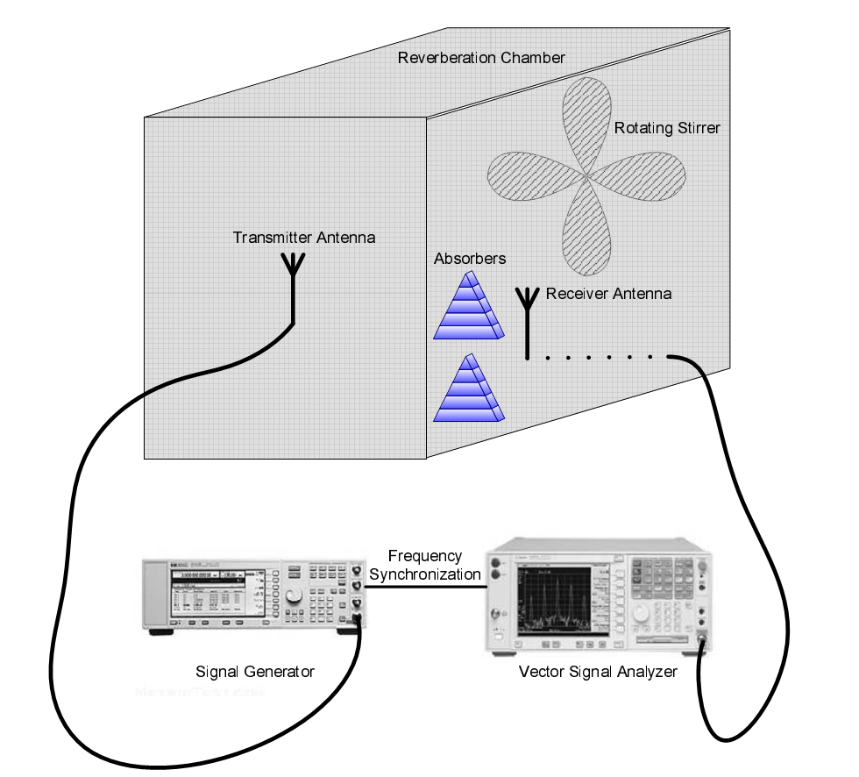
REVIEW OF IA TESTBEDS
  IA testbeds under more realistic conditions, e.g., reverberation chamber.
© Guzelgoz, S. Characterizing Wireless and Powerline Communication Channels
with Applications to Smart Grid Networks, 2011, PhD. thesis

Slide 13
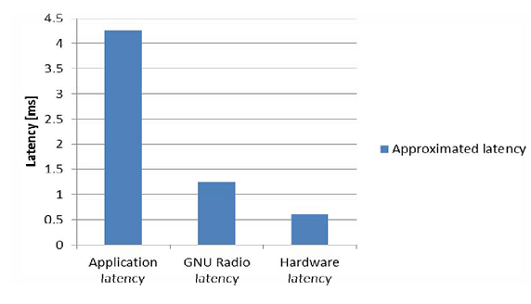
REVIEW OF IA TESTBEDS
Wideband signals
  Higher bandwidth, lesser tolerance on latency
    Peripheral component interconnect (PCI) extensions for instrumentation (PXI)
  LTE compliant OFDM symbol times
© Truong, N.B. et. al, Latency Analysis in GNU Radio/USRP-based Software Radio Platforms, Nov. 2013

Slide 14
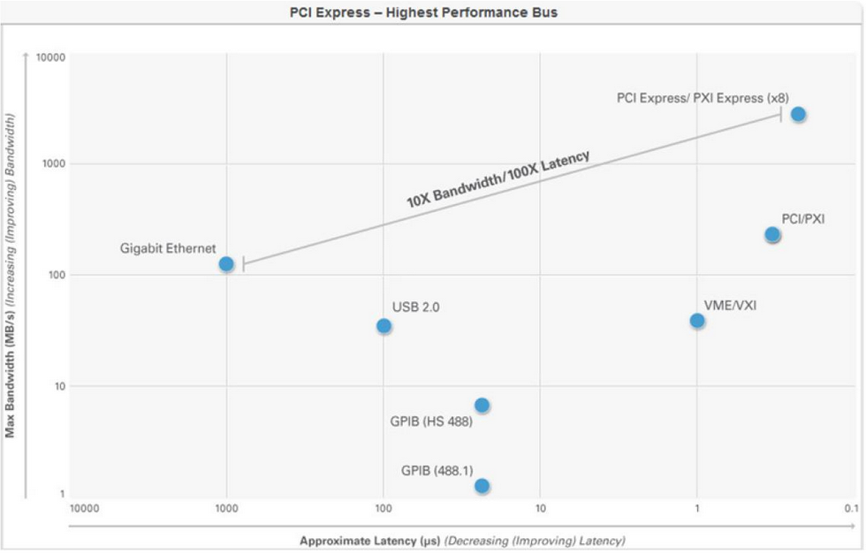
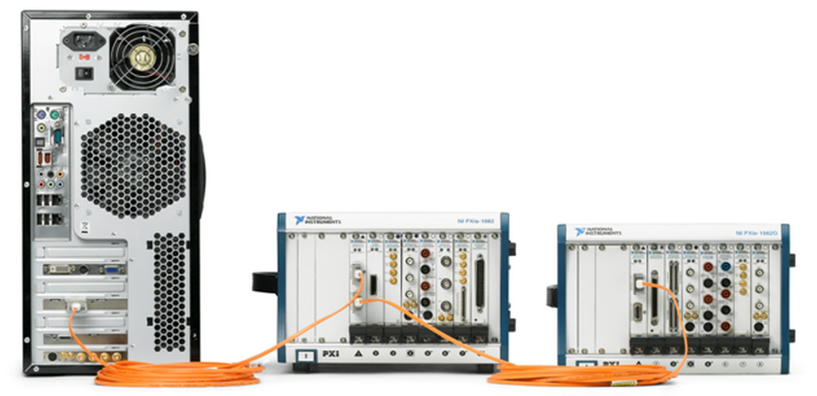
REVIEW OF IA TESTBEDS
© NI, www.ni.com

Slide 15
Part II - Review of SDR testbeds

Slide 16
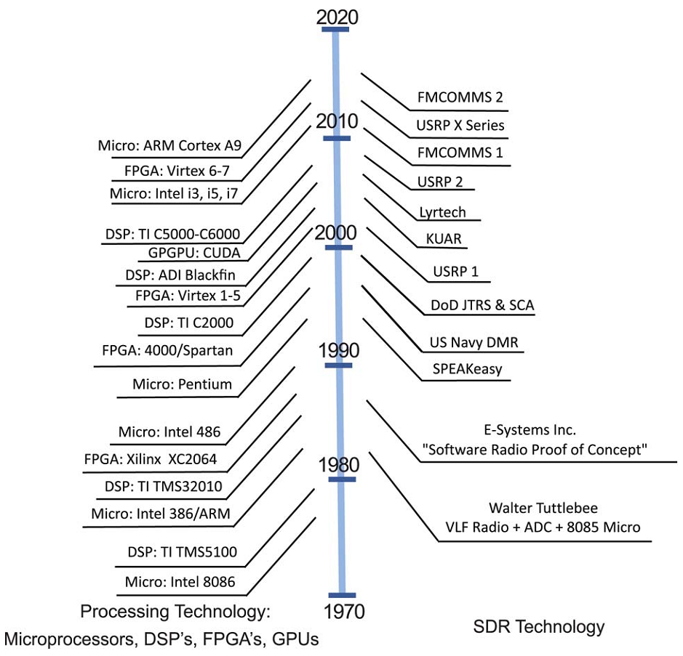
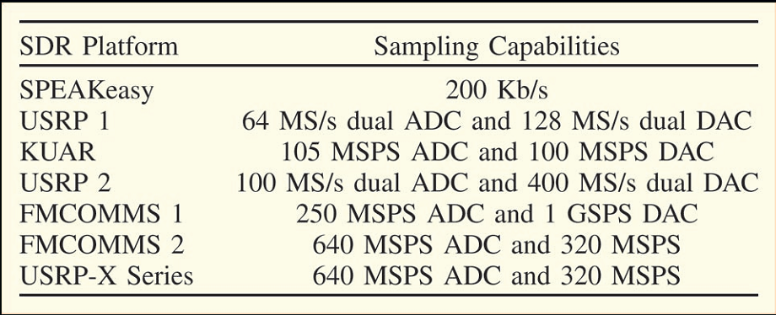
Review of sdr testbeds
Sampling capabilities of different SDR platforms
Processing technology vs. SDR technology
© Machado, R. G. and Wyglinski, A. M., Software-Defined Radio: Bridging the Analog–Digital Divide,
March 2015, Proceedings of the IEEE

Slide 17
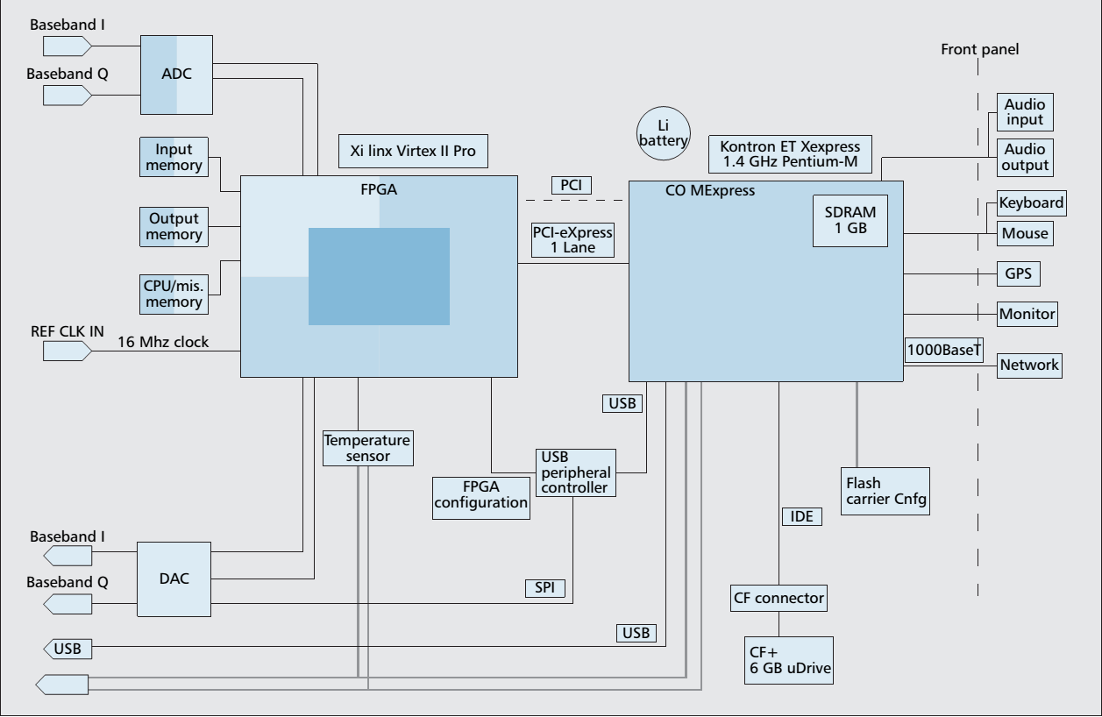
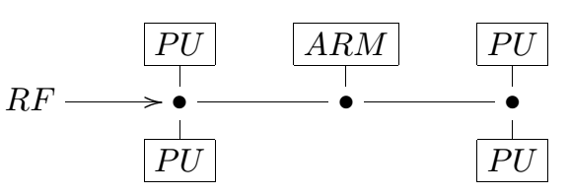
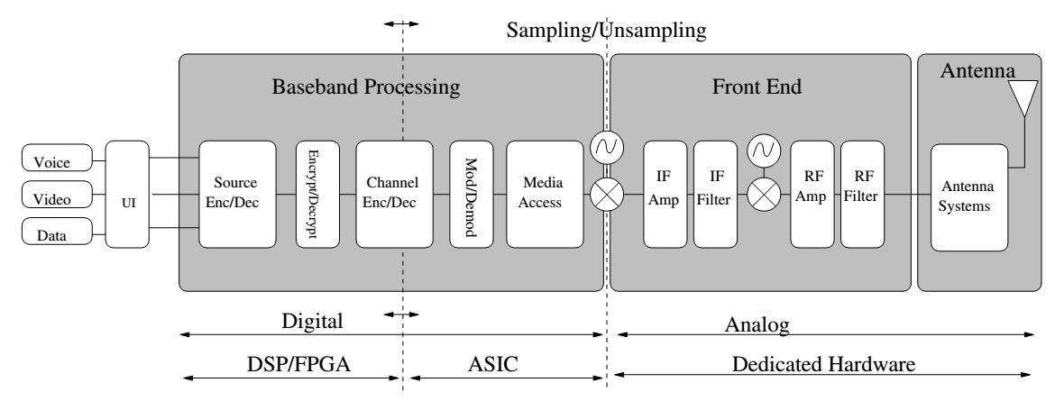
Review of sdr testbeds
Different architectures
  General-purpose CPU approach (USRP)
  Co-processor approach
  Processor-centric approach
  Configurable units approach
  Programmable blocks approach (Rice University-WARP, Lyrtech)
  Distributed approach
© Dardaillon, M. et.al, Software Defined Radio Architecture Survey for
Cognitive Testbeds, March 2013

Slide 18
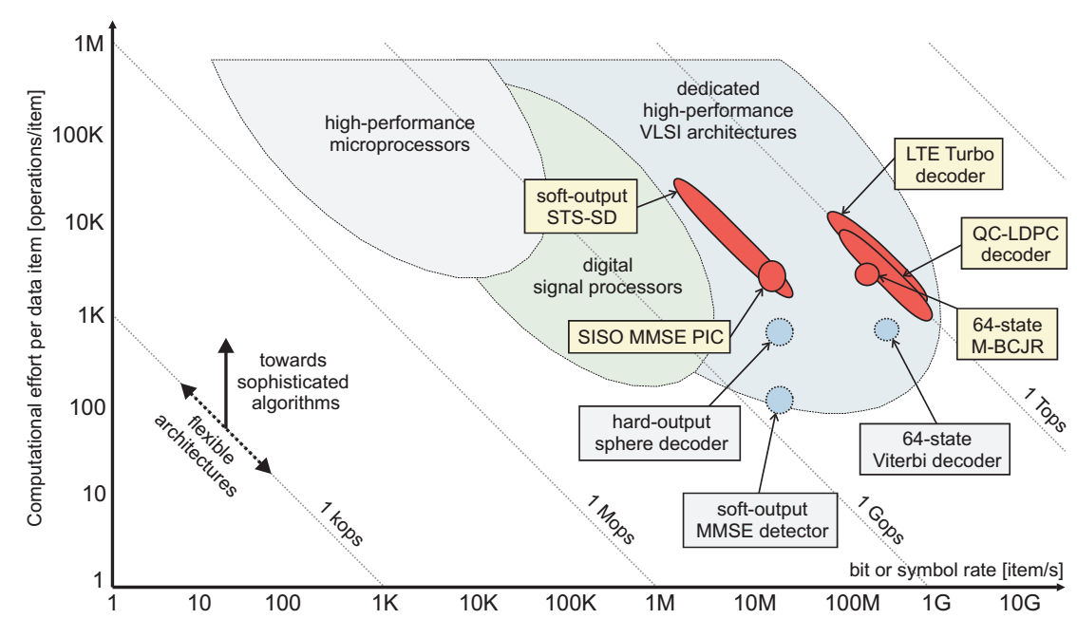
Review of sdr testbeds
© Studer, C., Iterative MIMO Decoding: Algorithms and VLSI Implementation Aspects, 2009

Slide 19
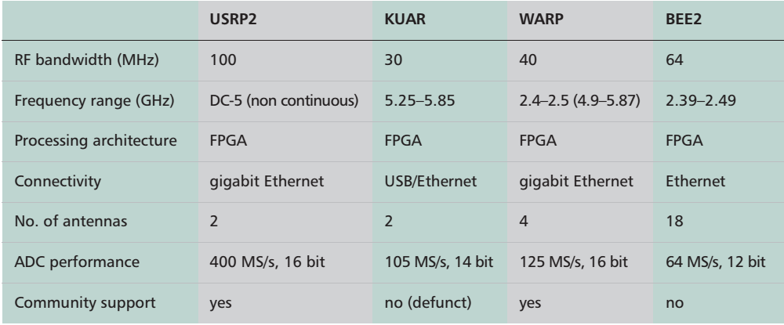
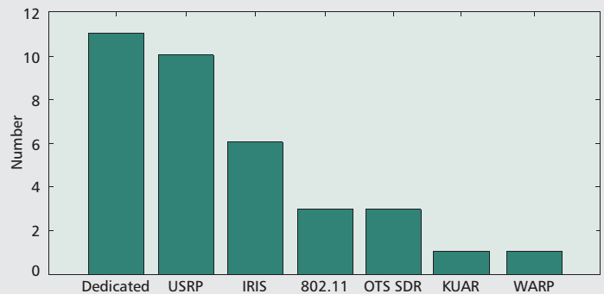
Review of sdr testbeds
© Pawelczak, P. et. al, Cognitive Radio: Ten Years of
Experimentation and Development, March 2011

Slide 20
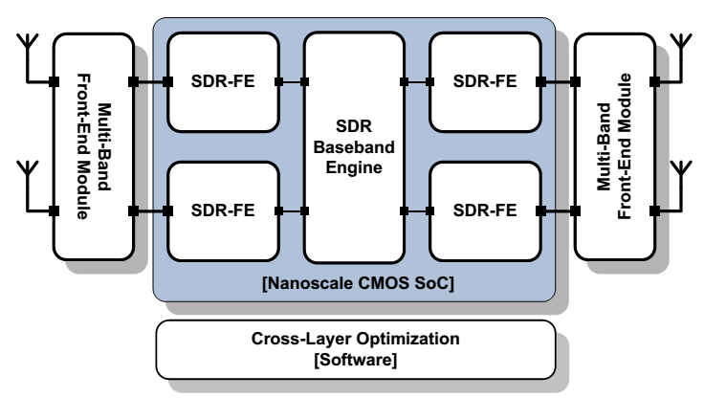
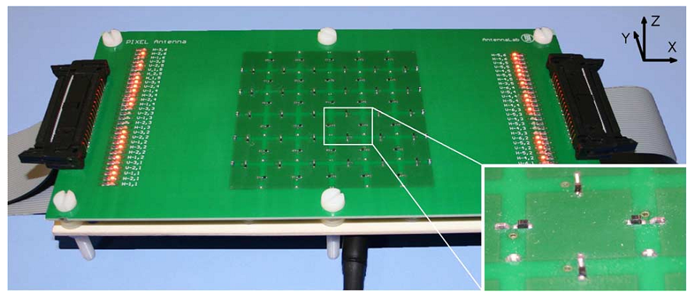
Review of sdr testbeds
Future status
  CMOS
  Direct conversion transceivers
    ADC/DAC is placed as near as possible to the antenna, RF signal is sampled directly without downconversion
  Software-defined antennas
    reconfiguring the operating frequency, radiation pattern and polarization.
© Craninckx, J. et. al, SAW-less software-defined radio transceivers in 40nm CMOS, Sept. 2011
© Rodrigo, D. et. al, Frequency, Radiation Pattern and Polarization Reconfigurable Antenna Using a Parasitic Pixel Layer, June 2014

Slide 21
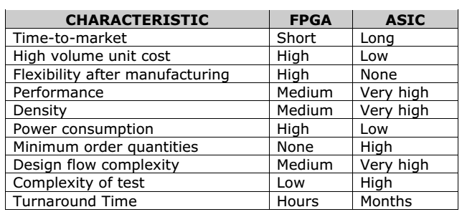
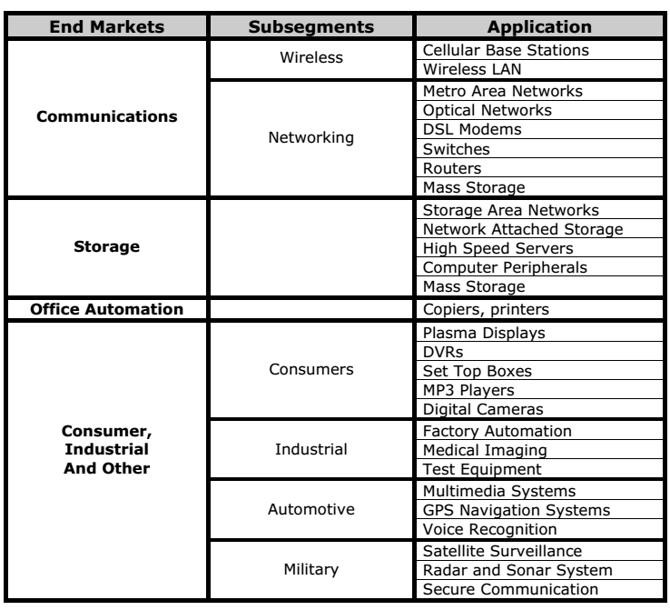
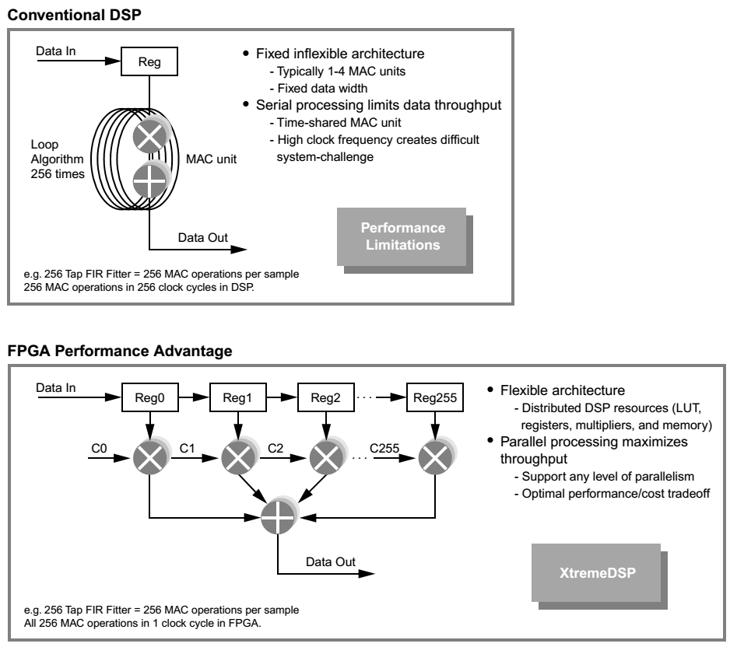
Review of sdr testbeds
© Scekic, O. FPGA Comparative Analysis, 2005
© Xilinx, www.xilinx.com

Slide 22
Review of sdr testbeds
Dedicated designs for IA
  Studer, C. et. al, ASIC Implementation of Soft-Input Soft-Output MIMO Detection Using MMSE Parallel Interference Cancellation
  Wu, M. et. al, Large-Scale MIMO Detection for 3GPP LTE: Algorithms and FPGA Implementations
  Dick, C. et. al, Implementing a Real-Time Beamformer on an FPGA Platform
  Murphy, P. et. al, FPGAs Help Characterize Massive-MIMO Channels

Slide 23
THANK YOU

